Slide 1
Analyzing Different Neighborhoods in Toronto
Coursera Capstone

Slide 2
Problem Statement
What is the best neighborhood in Toronto for a large, family-oriented company to expand to?

Slide 3
Objective
Clean data provided by Wikipedia to find a succinct list of neighborhoods in Toronto
Use the Foursquare API to determine the most common venues in all neighborhoods in Toronto
Analyze the data provided by Foursquare API to determine which neighborhood is best fit for the company and its employees

Slide 4
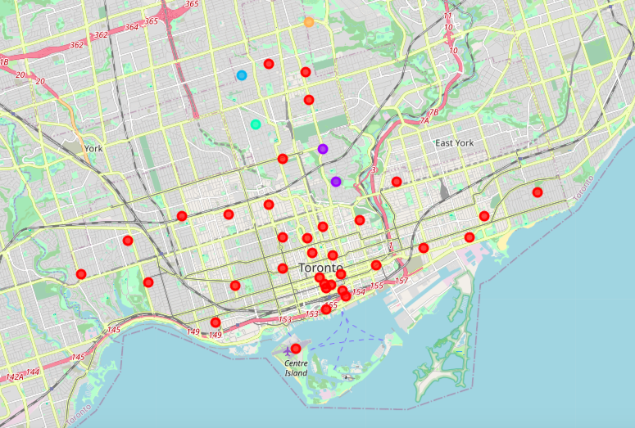
Toronto Neighborhood Clusters

Slide 5
Summary of Toronto Neighbhorhoods
Toronto has 38 different neighborhoods
There are 237 different types of venues in the 38 neighborhoods
The most common venues are coffee shops, cafes, and restaurants
Some neighborhoods are residential, some are touristy, and some are industrial

Slide 6
Conclusion
Based on the venues in all 38 neighborhoods, I would recommend for the company to expand to either Lawrence Park or Rosedale
Rosedale would be better fit for a younger audience (preschoolers, elementary schoolers, etc.)
Lawrence Park would be better fit for a slightly older audience (high schoolers)
Both neighborhoods are family friendly and would be great for employees to settle in

